Slide 1



Hotel Bookings Analysis Dashboard On Power BI
Jothiprasath Muthukumar (1556)
Associate Technical Consultant
PD – Enterprise Analytics and Data Science

Slide 2
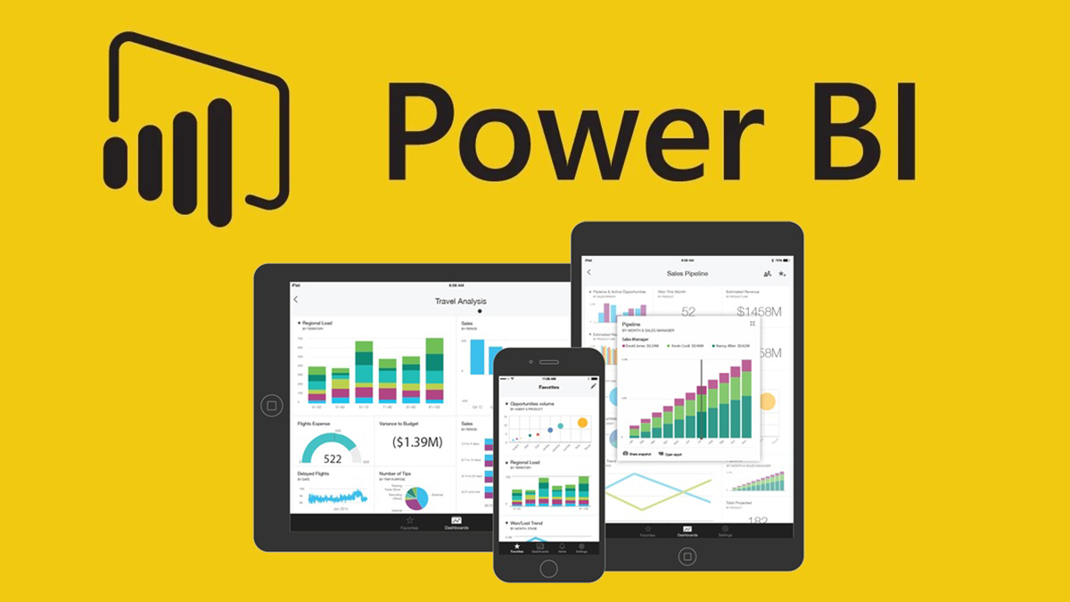
What is Power BI?
Microsoft's comprehensive data analytics solution designed to collect, analyze, and visualize data from diverse sources.
Data Connects: Easily links to various data sources.
Visualizes Insights: Creates interactive dashboards and visuals.
Enables Collaboration: Facilitates secure sharing and teamwork.

Slide 3
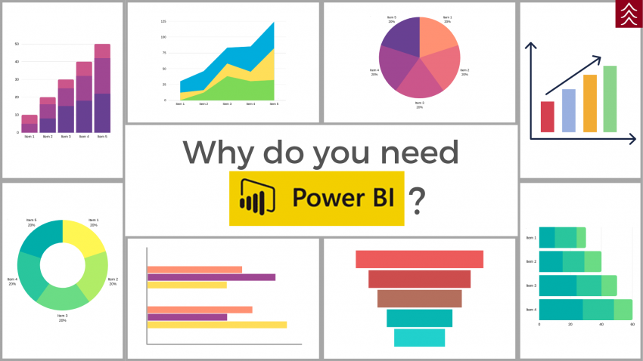
Importance of Power BI
Simplifies complex data for clearer understanding
Communicates insights effectively through visualization
Supports detailed analysis and predicts trends for informed decisions
Enables quick responses by monitoring real-time data
Accessible to users of varying technical skills

Slide 4
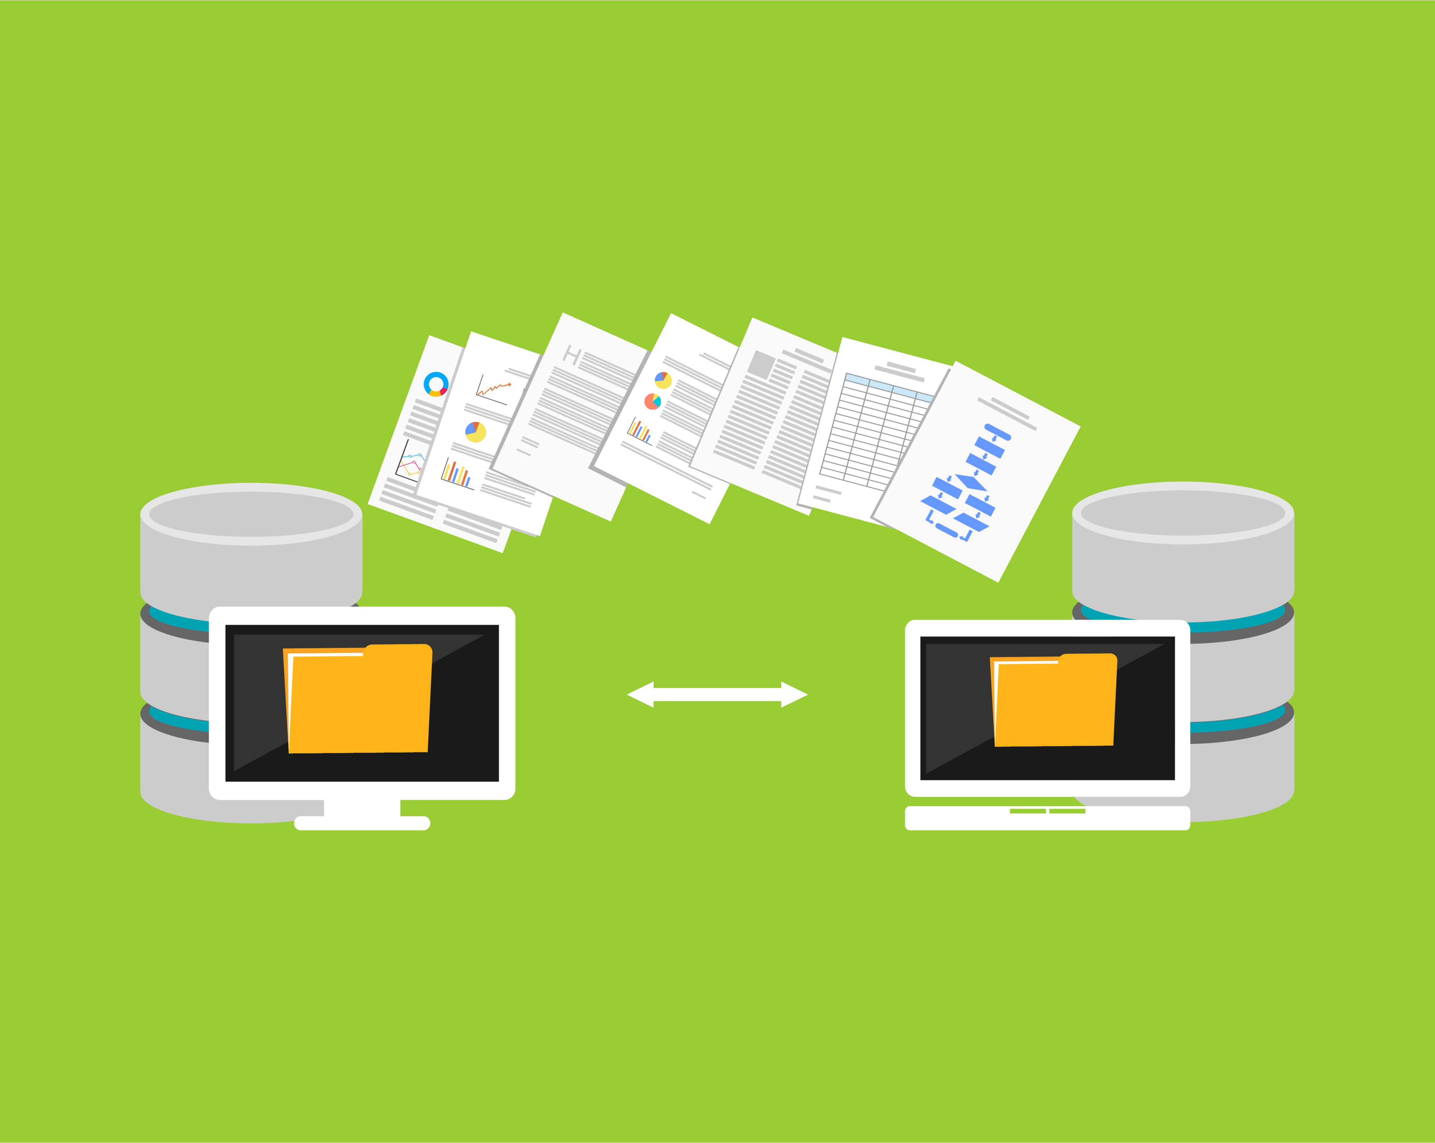
Import Data, Direct Query, Live Connection
Import Data:
Involves loading data from a source into the Power BI file itself, suitable for smaller datasets or when data doesn't frequently change.
Direct Query:
Allows Power BI to query the data source in real-time without importing the data, ideal for larger datasets or when data needs to be immediately reflected in reports.
Live Connection:
Maintains a direct, live connection to a data source (such as on-premises databases), enabling Power BI to query the source directly when generating reports.

Slide 5
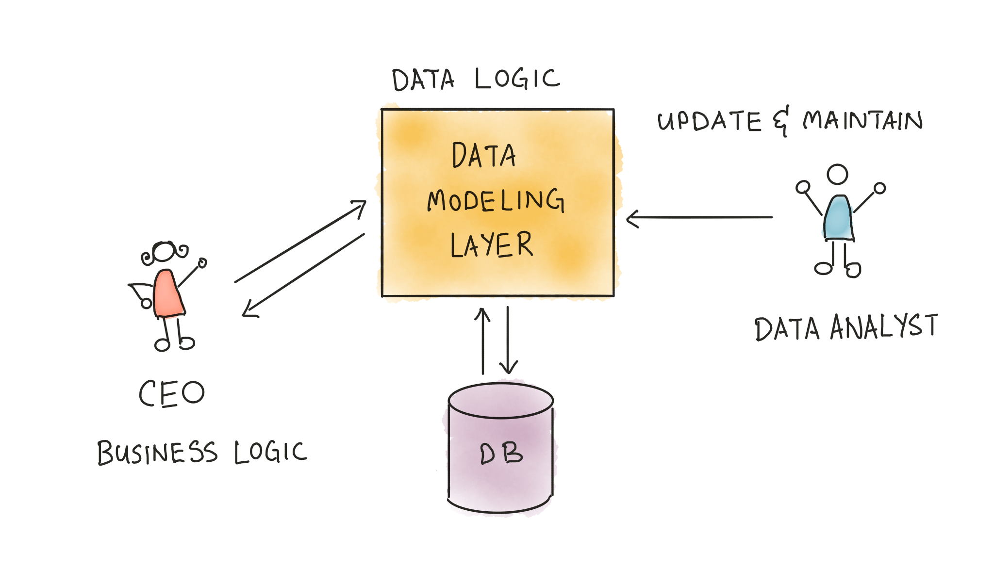
Data Modeling
Involves structuring raw data into a logical framework for analysis
Establishes relationships for efficient querying and trend identification
Simplifies complex datasets, making it easier to identify patterns

Slide 6
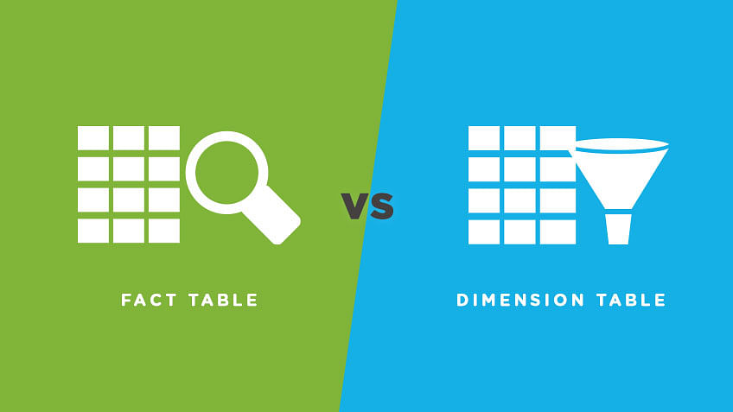
Facts & Dimensions
Consists of measurable data points representing business metrics like sales revenue, quantity sold, etc.
Aggregated Values: Summarized insights into business performance
Dimensions: Descriptive attributes providing context to the facts

Slide 7
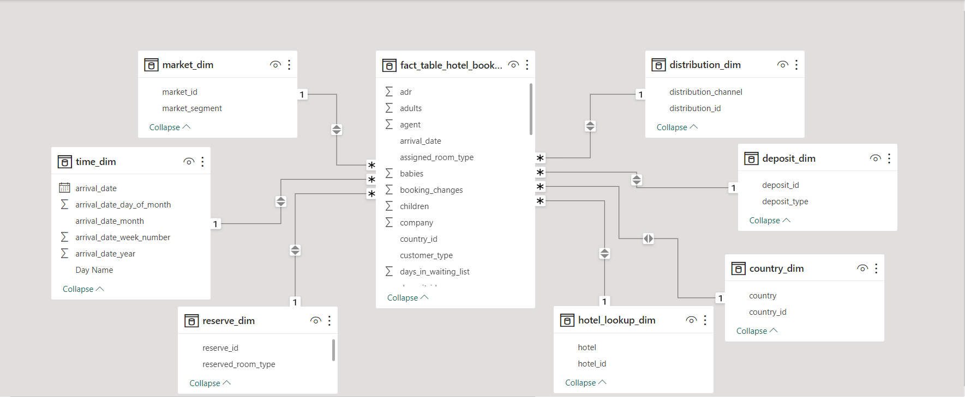
Star Schema
The Star Schema in Power BI organizes data into a central fact table surrounded by dimension tables, forming a simple and intuitive structure.
It accelerates data analysis by linking numerical facts in the fact table with descriptive attributes in dimension tables.
Optimizing query performance and facilitating comprehensive reporting.

Slide 8

Views
Report View:
Showcases data insights through charts, graphs, and customizable visuals. Enables users to interact with visualizations for deeper exploration.
Table View:
Displays raw data in a tabular format for closer examination and analysis. Allows users to filter and sort data based on specific criteria.
Model View:
Displays the data model's schema, illustrating connections between tables and their attributes. Aids in comprehending data hierarchies and relationships for efficient querying.

Slide 9
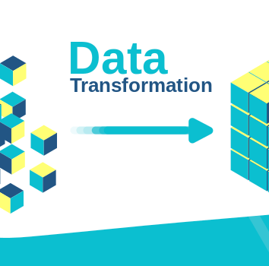
Cleaning & Shaping
Refining
Manipulating data to fit specific reporting and analysis requirements.
Involves removing duplicates, handling missing values, and restructuring data for analysis.

Slide 10

Power Query allows seamless connectivity to various data sources and performs transformations before loading into Power BI.
Data Connectivity: Connects to multiple sources, fetches data, and performs initial transformations.
Transformation Capabilities: Provides a user-friendly interface for data cleaning, shaping, and refining operations.

Slide 11


Calculated Columns | Calculated Measures
Add new data based on predefined formulas using existing columns in the same table. | Dynamically calculate without altering table data.
Formula or expression within the same table. | Calculations for comprehensive analysis, not limited to basic arithmetic.
Create new metrics, categorize data, derive specific insights. | Enables sophisticated analyses within multidimensional datasets.

Slide 12
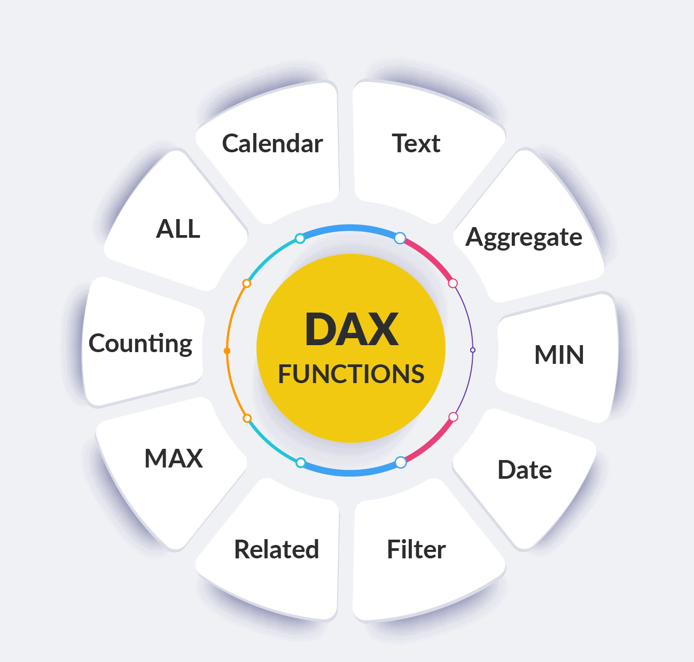
Formula Language for manipulating data in Power BI
A rich set of functions in Power BI allows for aggregation and filtering
SUM,AVERAGE,CALCULATE,COUNTROWS,DIVIDE,COUNT,FILTER
Enabling data manipulation to create customized columns and measures.

Slide 13

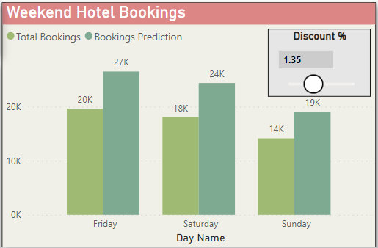
A powerful tool for exploring scenarios by changing values in reports
Enables data manipulation for predicting outcomes based on parameter adjustments

Slide 14
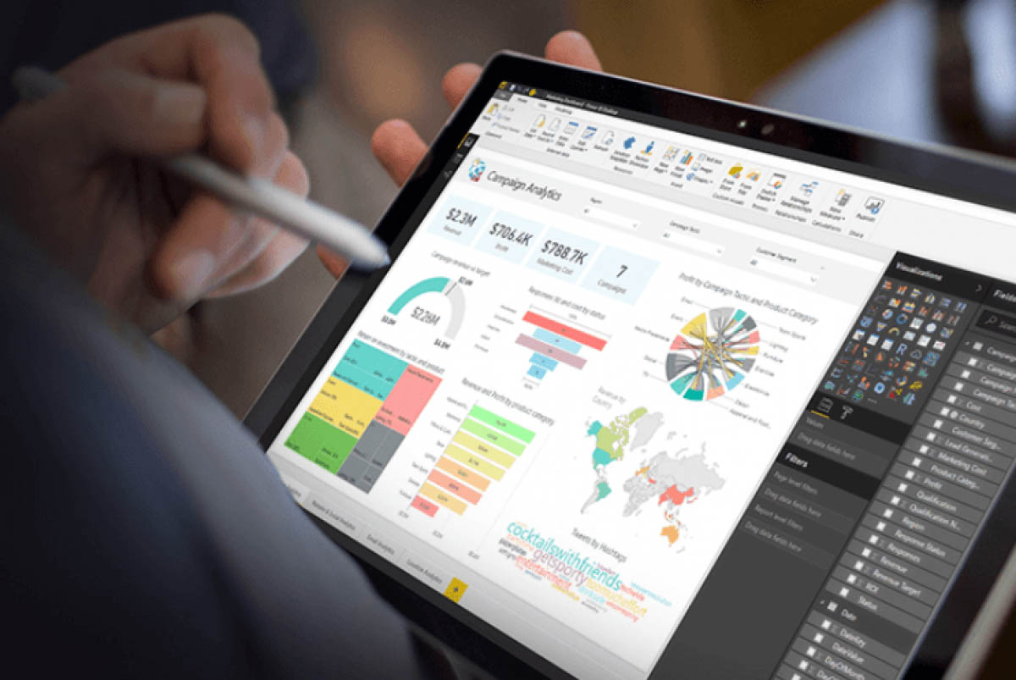
Bookmarks & Selection
Bookmarks save different data views, including selections and filters, allowing easy navigation for comparing insights within a report.
Selection allows users to interactively filter and highlight data through visual-level selection, slicers. It enables dynamic exploration, drill-down for deeper insights into the data.

Slide 15
Performance Analyzer
The Performance Analyzer in Power BI is a tool that tracks and displays loading times for each visual element in a report or dashboard.
It identifies bottlenecks, helps optimize visuals, data models, and queries, and offers real-time monitoring for performance improvements.
It's crucial for enhancing user experience, troubleshooting issues, and ensuring reports load quickly and efficiently.

Slide 16

Drill Down
Drill down in Power BI enables users to explore data hierarchies by delving into detailed levels of information from summarized data, offering deeper insights and context within visuals.
Drill-Through
Drill-through in Power BI enables users to navigate from one report page to another for more detailed information on specific data points, providing deeper insights without cluttering the main view.

Slide 17

Custom Visuals
Extend
Allow users to access a wide array of visuals beyond the standard Power BI offerings.
Encourage
Encourages creativity in data representation for unique and impactful insights.
Enable
Enables clearer communication of complex data patterns to diverse clients.

Slide 18

Data Security in Power BI
Row-Level Security (RLS): This feature allows you to control access to rows of data based on user roles or criteria. It's a critical security measure where you define rules to filter data rows dynamically.
Auditing and Monitoring: Power BI provides extensive auditing and monitoring capabilities. Administrators can track user activities, access logs, and usage patterns. This monitoring helps identify any unusual activities or potential security threats.
Data masking in Power BI secures sensitive data by selectively concealing information based on user permissions while enabling detailed analysis and reporting.

Slide 19
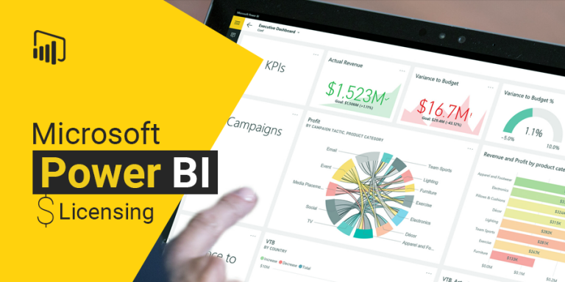
Power BI Free: It's the starting point, letting individuals explore basic data connections, create reports, and visualize information without any cost. Great for personal projects, smaller data tasks, or for those just getting familiar with Power BI.
Power BI Pro: This is where the collaboration and more advanced features come in. Businesses benefit from sharing capabilities, larger storage limits, scheduled data refresh, and the ability to access on-premises data. It's the go-to choice for teams needing to work together on data and reports.
Power BI Premium: Designed for the big leagues. It offers dedicated resources, scalability, and advanced analytics. Crucial for larger organizations heavily invested in data, needing extensive management, and scalability across the board.
Power BI Embedded: Tailored for developers, it facilitates seamless integration of Power BI analytics into applications or websites. Featuring usage-based pricing, scalability, and customization options, it doesn't require individual user licenses.

Slide 20

Power BI Services
The Power BI Gateway acts as a bridge between on-premises data sources (such as databases, files, or other systems) and the Power BI service hosted in the cloud. It enables secure and efficient data transfer, allowing Power BI to access and refresh datasets stored on local servers or systems that aren’t directly connected to the cloud.
On-premises Data Gateway: This is the most common type of gateway used in Power BI. It allows connections to on-premises data sources without requiring the migration of the entire dataset to the cloud.
Personal Mode Gateway: Designed for individual use, allowing a single user to connect to on-premises data sources from Power BI.

Slide 21
Power BI Services
Security: Gateways enforce security measures, to protect data transmitted between the on-premises environment and the Power BI service. They also allow administrators to control access and permissions for data sources.
Data Refresh: Gateways enable scheduled data refreshes in Power BI for on-premises data sources, ensuring that reports and dashboards have the most up-to-date information.

Slide 22

Scheduled Refresh: Regularly updates data based on a defined schedule
On-Demand Refresh: Manually triggers data refresh
Live Connection: Provides real-time data updates for dynamic reporting

Slide 23
THANK YOU

